Slide 1


Slide 2


Introduction
01
Liam Whorriskey
Project
On-line system to take in building details for analysis. CrowSoft is a engineering and tech company. The product that they wish to market is BusIntelligence.
The system must take details for buildings and to provide easy to use analysis features. For example, they may wish to have a review all buildings which cost more than €1 million to build and have special features as this may indicate future maintenance projects that may be exploited. Keep the analysis simple.
The analysis system should be clean and simple. The system needs to take into account the usual details and present simplified graphics. It must be possible to upload files or images.
The administrator should be able to access detailed information and edit as appropriate. Once the client enters details it should not be able to be changed by the client.
Liam Whorriskey

Slide 3






Team Members
01
02
Liam Whorriskey
Charles Aylward
Mary Walsh McGinty
Joji Thokla
Matthew Mc Colgan
Matthew Mc Colgan
Bharathi Gadhiraju
Michael McFadden
Colin Kenny
Liam Whorriskey

Slide 4
Agile Development / Team Collaboration
01
03
Matthew
Requirements
Tools
Backlog
Sprints
Michael McFadden
Scrum

Slide 5
Scrum
01
04
Michael McFadden
Communication
Sprint Planning
Daily Standup
Sprint Review
Sprint Retrospective
Slack
Zoom
Jira Comments
Hosted by Scrum Master
1 week Sprints
Apply a Sprint goal
Prioritize backlog Stories
Manage total Sprint story points according to previous Sprint
Hosted by Scrum Master
Attendance
15 min Standup
Standup Structure
Pass the ball
Hosted by Scrum Master
Attendance
Duration 1hr
After each sprint
Showcase completed work
Sprint Report
Team Comments on Slack
Retrospective Structure
Retrospective Report
Trends where visible
Work harder on areas of improvement
Rotating
Scrum Master
Hosted by:
Scrum Master
Alternate Weekly
Structure:
What I did?
What I will do?
What was my impediment?
Attendance
Scrum Master
Dev Team
PO
Structure
What went well
What didn’t go well
How can we improve
Liam Whorriskey

Slide 6


Jira
05
Liam Whorriskey
Plan
Create user stories and issues, plan sprints, and distribute tasks across your software team.
Track
Prioritize and discuss your team’s work in full context with complete visibility.
Release
Ship with confidence and sanity knowing the information you have is always up-to-date.
Report
Improve team performance based on real-time, visual data that your team can put to use.
Mary Walsh

Slide 7



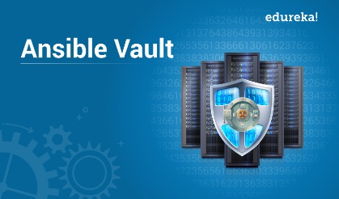


Security Tools
01
06
Mary Walsh
Puma Scan
SonarQube
Checks C# and .NET vulnerabilities
Static analysis of code
OWASP
Ansible Vault
Dependency check
Project dependencies
Encrupt sensitive data to store in source code
Charles Aylward
Open SCAP
Audit Trail
Multiple tools, help with enforcement of security baselines
Logs. Display to console or can be saved to log file on a server

Slide 8
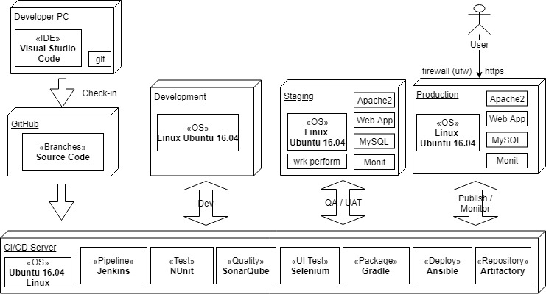
Dev Staging & Production
01
07
Charles Aylward
Charles Aylward

Slide 9
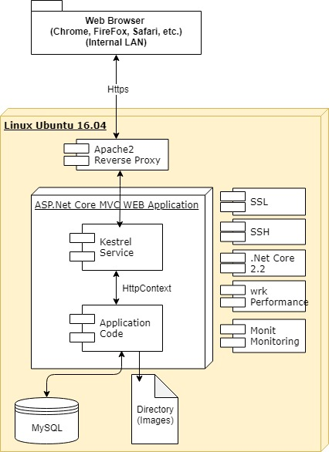

Environments – Technology Stack
01
08
Charles Aylward
https
Colin Kenny

Slide 10
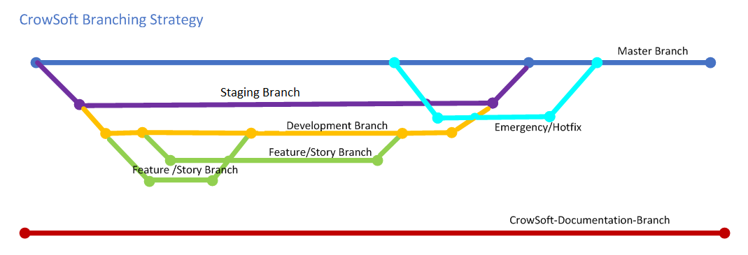
Git & GitHub
01
09
Colin
GitHub: https://github.com/rlennon/CrowSoft
Charles Aylward

Slide 11
Code Created - Solution
10
Charles Aylward
Web application access via a web browser
Customer Register and Login
Admin users to manage all users and allocate roles
Admin access/edit detailed Information
System calculates building cost analysis and display costing to the customer
Admin to manage costs exceed €1 million.
Charles Aylward

Slide 12
Code Created - Technical
01
11
Charles Aylward
Programming Language: C#, JavaScript and HTML
IDE: Visual Studio Code
Framework: .Net Core 2.2
Supporting Platforms: Windows, Linux, MacOS
Pattern: MVC (Model View Controller)
Type App: ASP.NET MVC Web Application includes bootstrapping
Database: MySQL
Security
Authentication: Token Based, Password hash (PBKDF2 algorithm with HMAC-SHA256, 128-bit salt, 256-bit subkey, and 10,000 iterations)
Authorization: Role-based Authorization
Hosting Server: Linux Ubuntu 16.04 (using Apache as reverse proxy)
Performance Tests: wrk Performance Tool (Open-source)
Coding Standards Documentation Completed
Exception Handling: Log4net
Colin Kenny

Slide 13
Jenkins Pipeline
01
12
Colin Kenny
GitHub
CrowSoft
Jenkins Server
Dev
Server
Workspace
Testing
Artifactory
Ansible
Charles Aylward

Slide 14
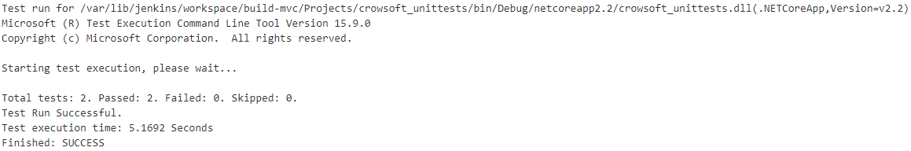
Unit Testing
01
13
Charles Aylward
Nunit for .Net Framework
Testing Controllers Actions (CRUD)
Automated on Jenkins Pipeline
Example:
Bharathi Gadhiraju

Slide 15
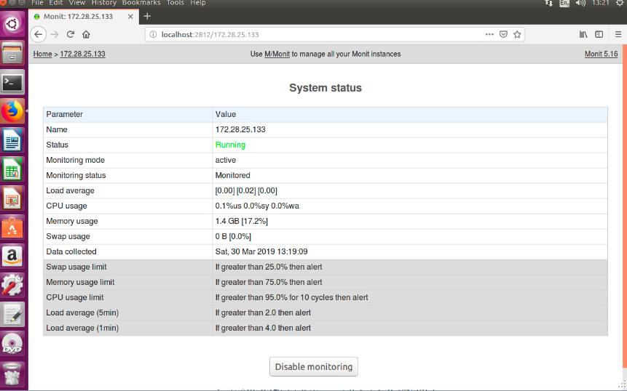
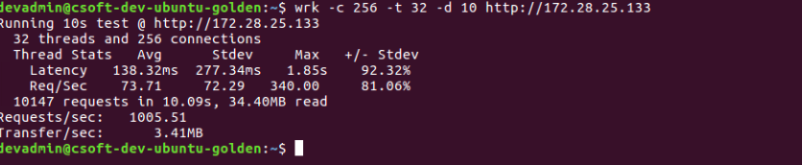
CodeQuality - SonarQube
01
14
Bharathi Gadhiraju
Jenkins Server
http://172.28.25.136:8080/
Monitoring Tool Monit Setup for CrowSoft
Performance Analyser
Wrk Setup for CrowSoft
To run wrk on the application, issue the below command
$ wrk -c 256 -t 32 -d 10 http://172.28.25.133
Job has reference
to git for
source code
Joji Thokala
SonarQube Server
http://172.28.25.123:8088/

Slide 16
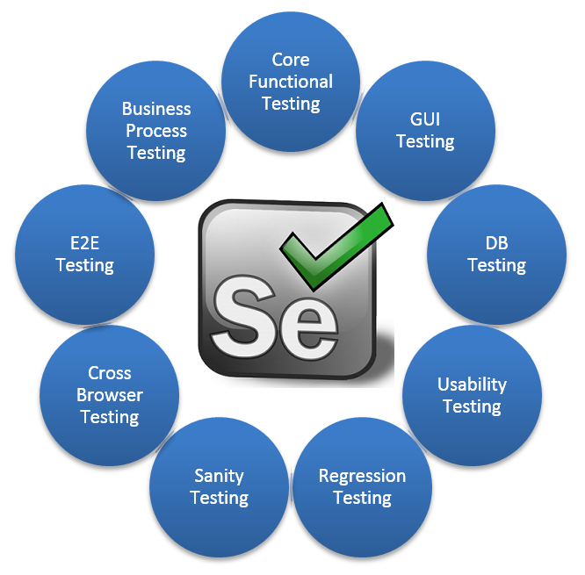
Selenium Service
01
16
Joji Pradhan Thokala
It is an open source project driver by Apache Foundation.
Free to use for both individual and Companies.
Conduct test on any browsers like Firefox,
Chrome, Internet Explorer, Opera and Safari.
Selenium runs on all popular operation systems like Windows, Linux, Mac Ubuntu.
Can write Selenium testing script in any programming language like Python, Java, C#, .Net, Perl and Php.
Selenium forms an integral part of Continues testing phase in DevOps life Cycle.
Selenium can easily integrated with lots of open source tools like Jenkins, TestNG, Maven, JUnit
Matthew Mc Colgan

Slide 17
Selenium
01
15
Matthew Mc Colgan
Selenium WebDriver is a UI testing framework
options.AddArgument("--headless");
Test Project created on Visual Studio
Mary Walsh
Automated via Jenkins
Test cases created

Slide 18

Artifactory
01
17
Mary Walsh
Retouching
Central
Location
Build Once
Deploy Often
Groups
Permissions
Limit
Access
Liam Whorriskey
Deploy
One Location

Slide 19
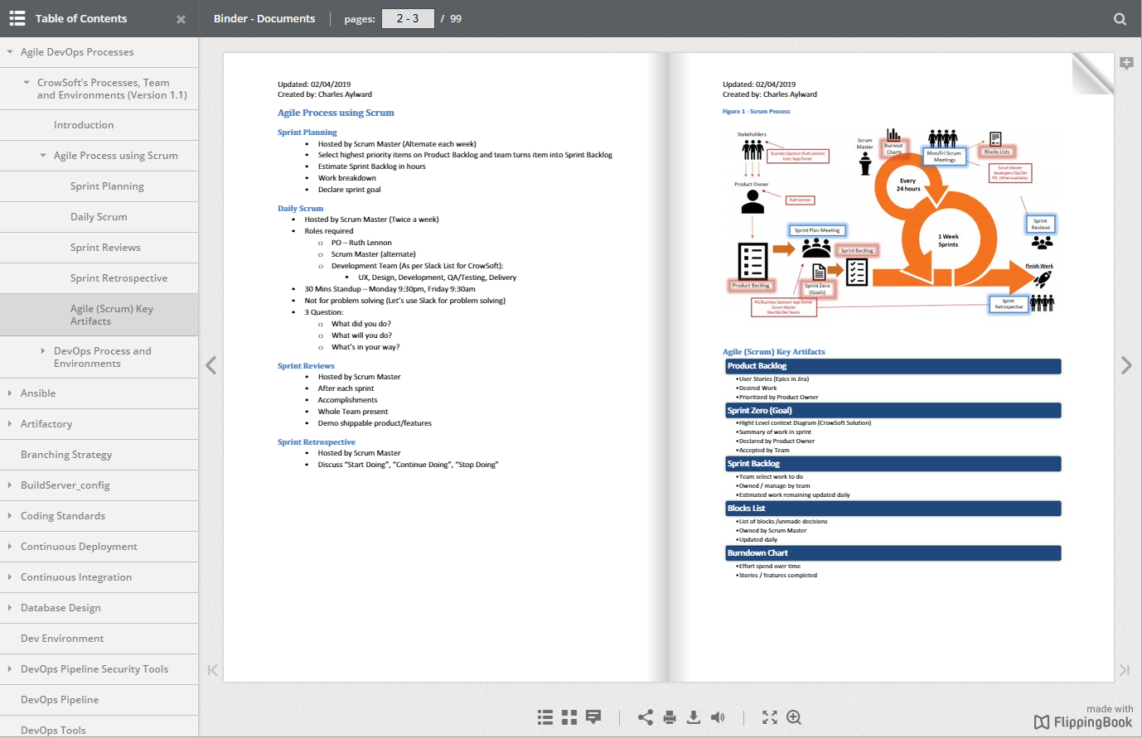
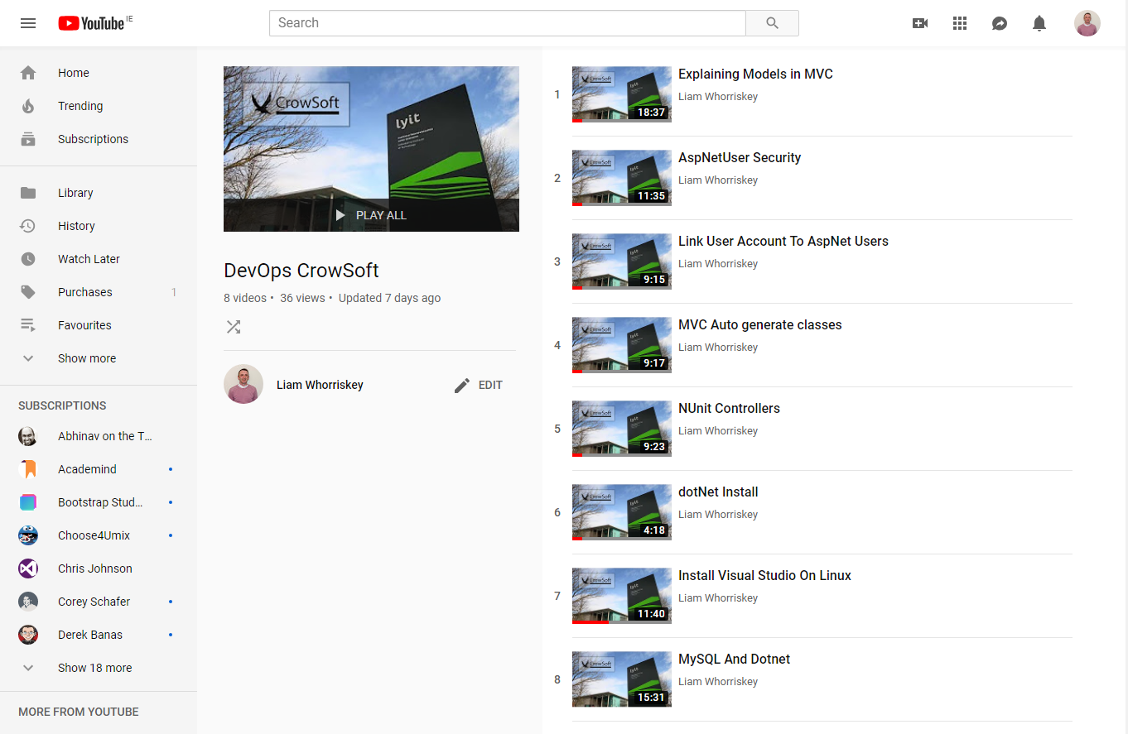
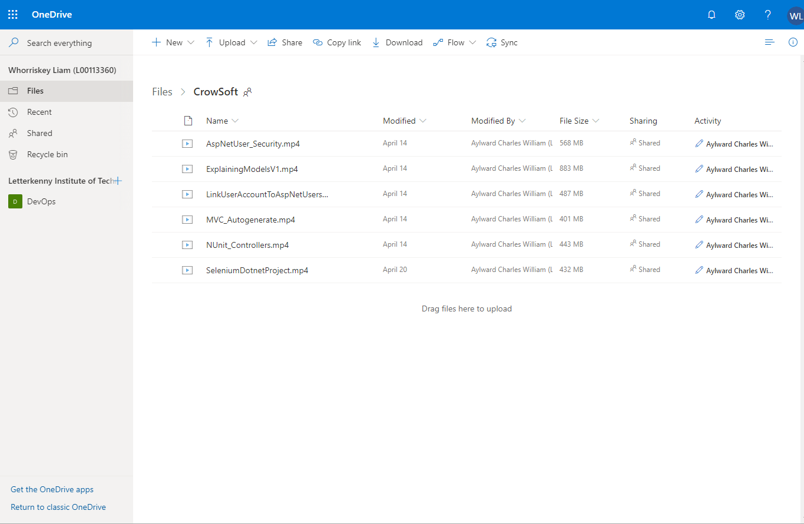
Documentation
01
17
Liam Whorriskey
Retouching
Flipping Book
Build Once
Deploy Often
Groups
Permissions
YouTube
OneDrive
Limiter
Access
Michael McFadden
Deploy
One Location
View
View
View

Slide 20
Disaster Recovery
01
18
Michael McFadden
Local Copy: Ireland
North America
Europe
Risk Management
Disaster Recovery Document
Personnel
Policy
Initiation
Response
Recovery
Backup policy
Restore procedures
Asia
Africa
Liam Whorriskey
South America
Australia
Traffic
Demand
Sales

Slide 21
Questions
Open Mic…

